Slide 1
NODE-303: Multi-Center, Multi-National,
Open-Label, Safety Study of Etripamil Nasal Spray for Patients With Paroxysmal Supraventricular Tachycardia
James E. Ip, MD, FACC, FHRS
Professor of Clinical Medicine
Weill Cornell Medicine
On behalf of: James E. Ip, MD; Benoit Coutu, MD; John H. Ip, MD; Peter A. Noseworthy, MD, MBA; Maria L. Parody, MD; Farhad Rafii, MD;, Samuel F. Sears, PhD; Narendra Singh, MD;
Bruce S. Stambler, MD; Naeem K. Tahirkheli, MD; Juan Agudelo-Uribe, MD; Derek Hu, MA;
Sarah Omodele, DN, FNP; Silvia Shardonofsky, MD; David B. Bharucha, MD, PhD; A. John Camm, MD

Slide 2
Disclosures
James E. Ip, MD:
  Received compensation as study investigator and steering committee member for Milestone Pharmaceuticals
  Received honoraria/speaking/consulting fees for Abbott Medical, Boston Scientific, and Medtronic Inc.
  Membership on advisory committee and/or steering committee for Abbott Medical and Medtronic Inc.
  Membership on data safety monitoring committee for Boston Scientific
  The NODE-303 trial and these analyses were funded by Milestone Pharmaceuticals.
  The trial was conducted and coordinated by Milestone and IQVIA, and over-read of ECG data was performed by
  Columbia Research Foundation.

Slide 3
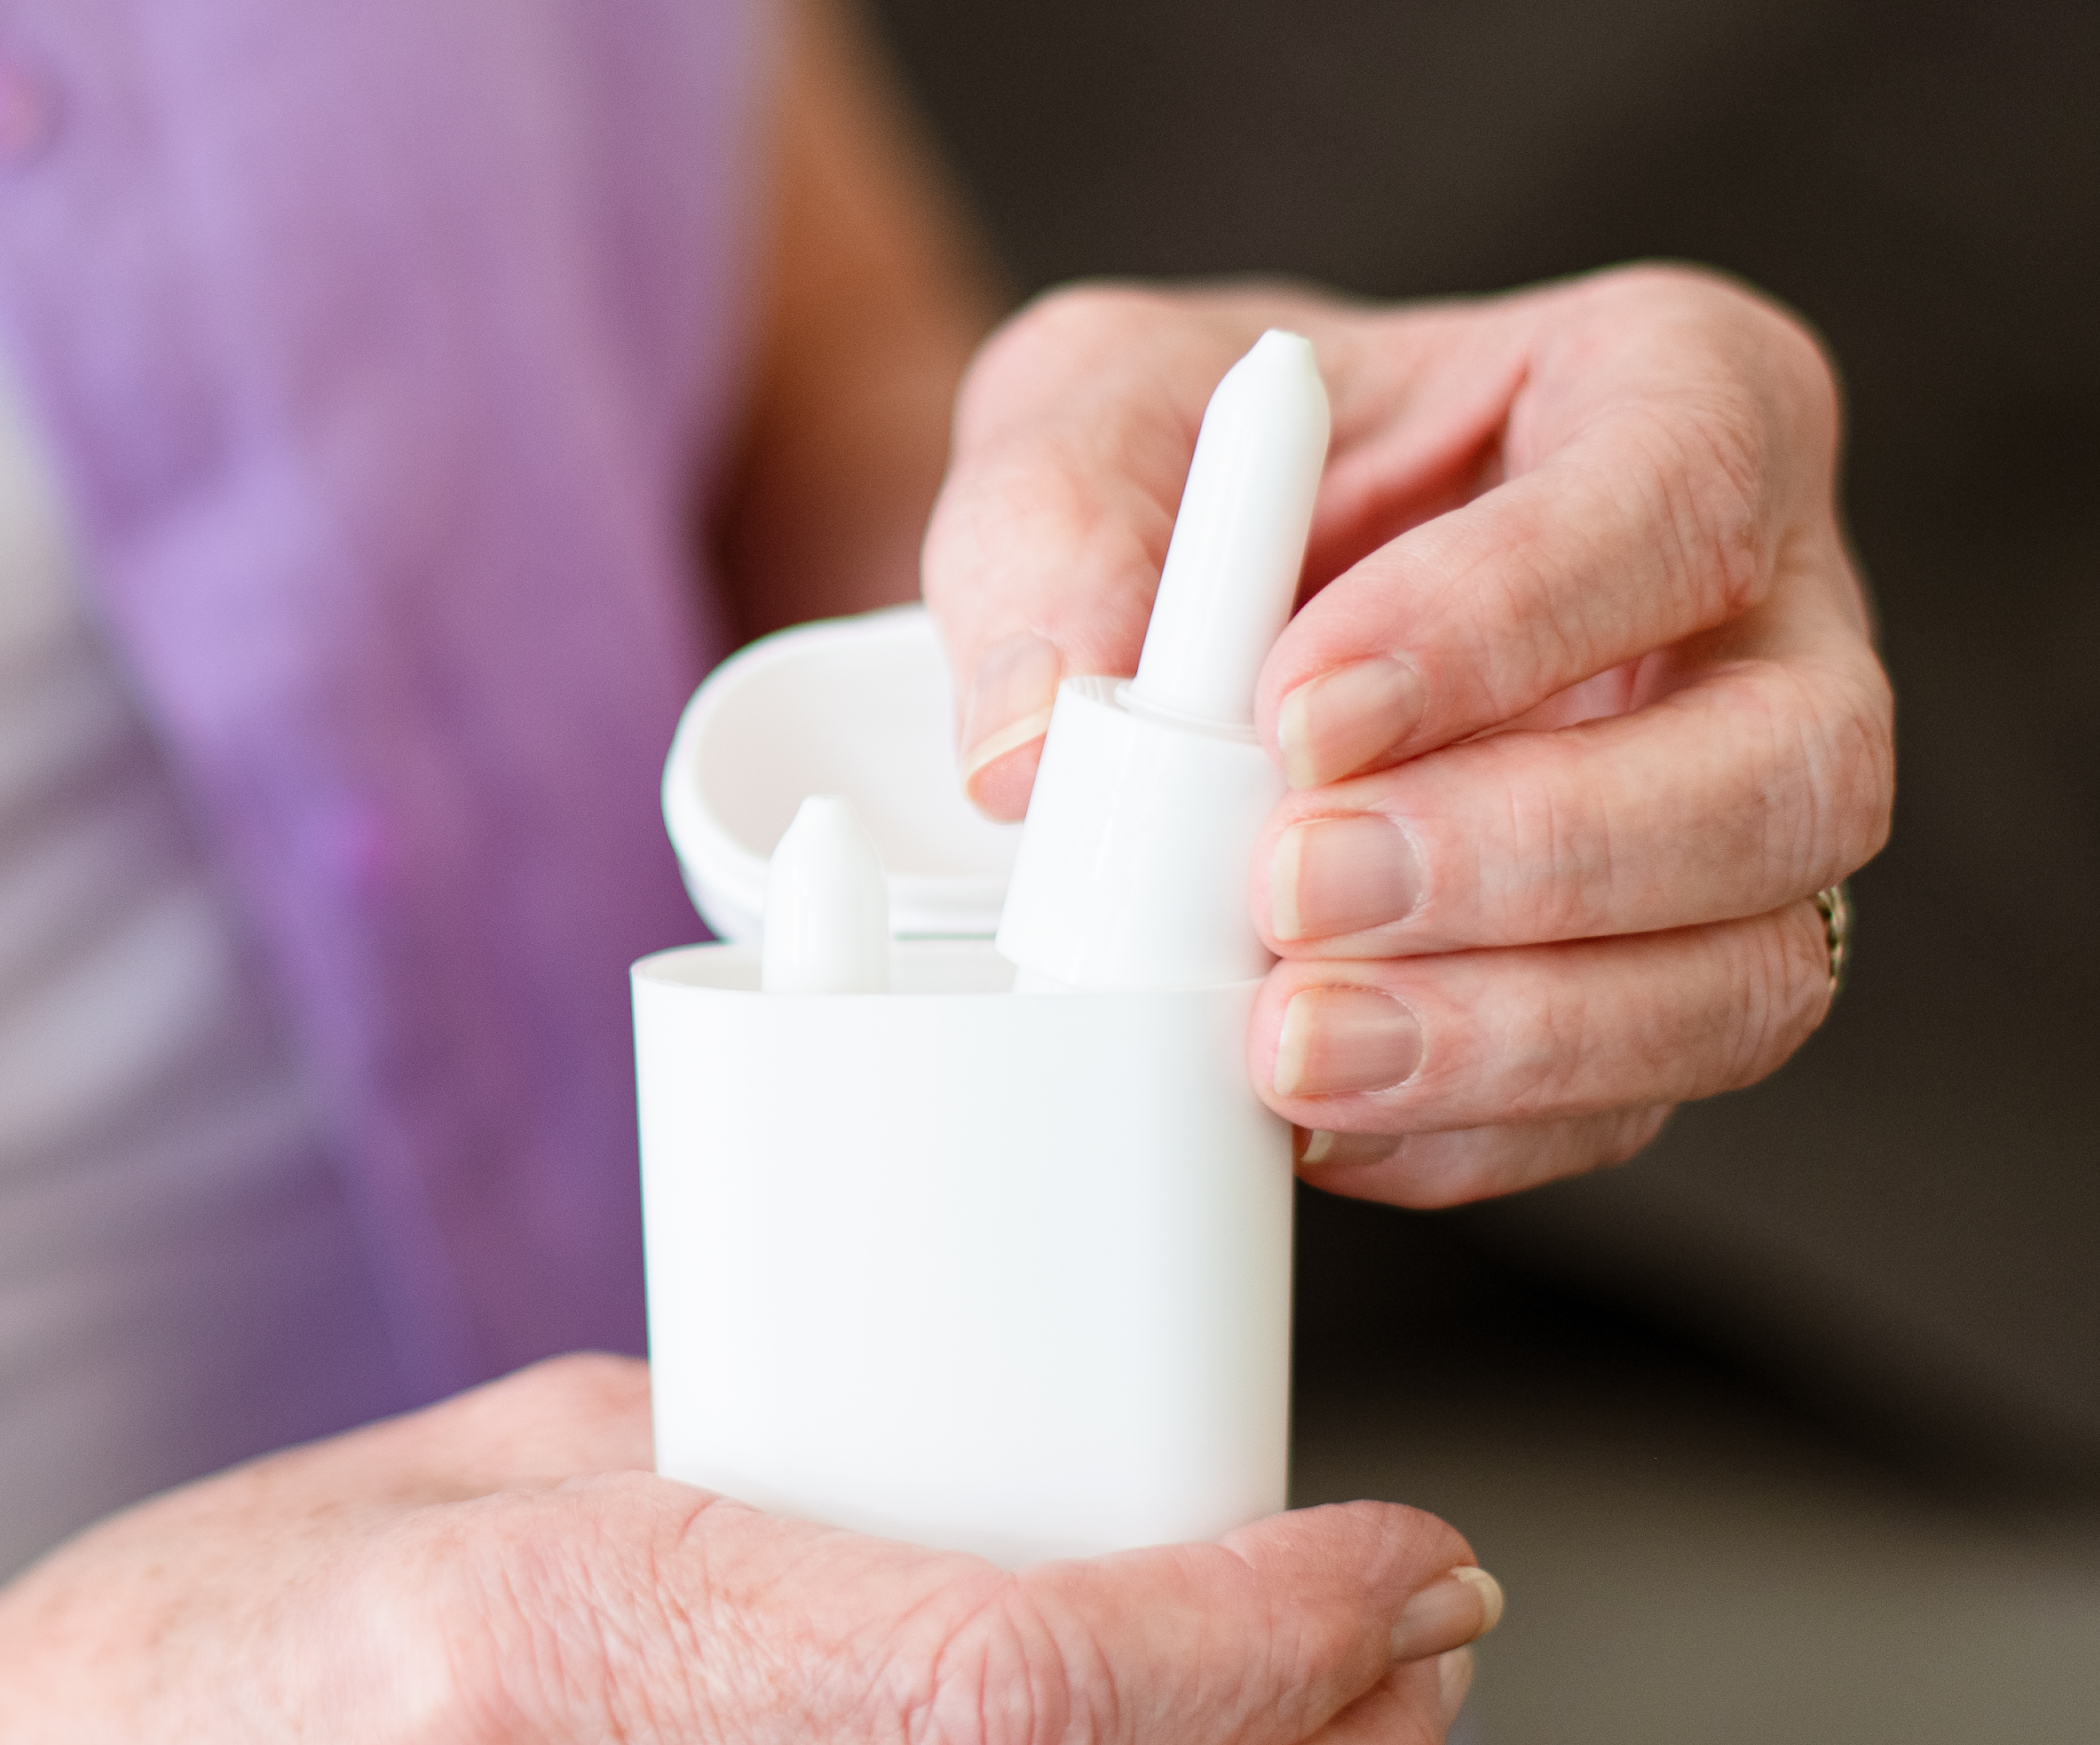
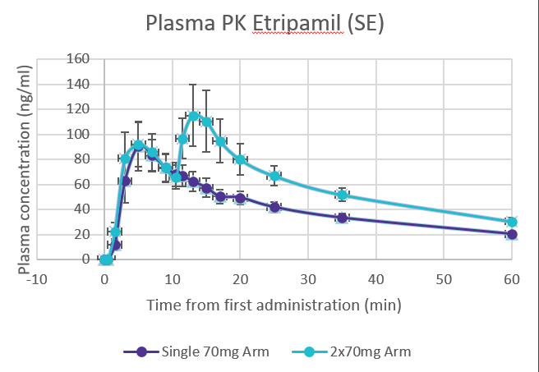
Etripamil: Potential New Treatment for PSVT
Novel, investigational, L-type channel calcium channel blocker
Formulated for intranasal spray with:
  Rapid onset of action (T_{max} ≤7 minutes)
  Metabolism: inactivation by blood esterases
Developed to satisfy unmet need for self-administered therapy that is convenient & safe outside the healthcare setting
Effective at rapidly terminating single episodes of
AV nodal–dependent PSVT
  Three phase 3 studies: NODE-301 Part 1, RAPID, NODE-302
Stambler BS, et al., J Am Coll Cardiol. 2018.
Wight D, et al. J Am Coll Cardiol. 2022 Mar, 79 (9_Supplement) 43.
Ip JE, et al. Lancet. 2023 July.
Ip JE, et al. Clin Pharmacol Drug Dev. 2024 Feb.
NODE-PK-101, -103, data on file.

Slide 4

RAPID: Conversion of Adjudicated PSVT to NSR at 30 and 60 min
Test dose required:
During Sinus Rhythm
Continuous ECG Monitoring
Serial BP Measurements every 5 min
1.3% test dose failure in RAPID study
Number of Patients at Risk
Median time to conversion: 17.2 min vs 53.5 min

Slide 5
NODE-303 Phase 3 Study Design
Real-world design:
No test dose
No exclusion of AF/AFL history
Multiple episodes (up to four)
Screening visit
Treatment period
End of study
Outcome measures
Key inclusion criteria
Patients ≥18 years old
Documented PSVT
Episodes lasting ≥20 min
Treated PSVT episode
Follow-up visit Additional study drug dispensed
Final visit
Study completion, discontinuation, or after 4th episode
Safety assessments
AEs
SAEs
Arrhythmias and conduction disorders detected on ECG
Patient recognizes symptoms
Applies cardiac monitor (ECG)
Attempts VM
Administers etripamil
70 mg intranasally
If symptoms persist for
10 min, dose
etripamil 70 mg againª
Keep cardiac monitor
for at least 1 hr
Key exclusion criteria
Evidence of ventricular
pre-excitation
2nd- or 3rd-degree AV block
History of severe symptoms of hypotension or syncope during PSVT
Efficacy assessments
Termination of PSVT
Frequency of additional medical interventions
Patient-reported outcomes
Additional
PSVT episodes
(up to 4 in total)
and
follow-up visits
ªApproximately 21 months after the study started, the protocol was amended to allow a repeat 70-mg dose to be self-administered if symptoms persisted 10 minutes following the first dose. If the symptoms of PSVT have not resolved within 20 minutes after study drug administration, the patient may seek appropriate medical care as needed. AE = adverse event. AF = atrial fibrillation. AFL = atrial flutter. AV = atrioventricular. ECG = electrocardiography. PSVT = paroxysmal supraventricular tachycardia. SAE = serious adverse event. SR = sinus rhythm. VM = vagal maneuver.

Slide 6
Patient Disposition and Analyses Populations
Patients screened
(N=1342)
Screen failure (n=226)
Eligibility criteria not met (159) Sponsor decision (11)
Withdrawal of consent by patient (13) Planned ablation (7)
ECG of concern (3) COVID-19 (1)
Physician decision (3)
Other (33)
Patients enrolled
(N=1116)
Patients in overall population but not in safety population
Did not receive any amount of study drug (613)
Safety population
Patients completed study ≥1 treated episodes
(N=503)
Reasons for exclusion in efficacy population
No relevant CMS data
PSVT converted prior to drug administration
Non-PSVT (Initial Diagnosis)
Efficacy
population
Patients completed study ≥1 treated confirmed episodes
(N=312)

Slide 7
Demographics & Baseline Characteristics (Safety Population)
 | Mean (SD) or Patients for Categorical Variables, n (%)
Age, y | 54.9 (13.6)
Sex, n (%)
Female | 344 (68.4)
Male | 159 (31.6)
Region, n (%)
North America | 353 (70.2)
South America | 150 (29.8)
Age at first PSVT diagnosis, y | 47.7 (16.8)
Time since first PSVT diagnosis, y | 7.0 (9.2)
PSVT episodes in past year, n | 9.8 (17.6)
Patient-reported emergency department visits for PSVT since diagnosis, n | 3.9 (5.7)
Patients with concomitant medications of interest, n (%)ª
β-blocker or calcium channel blocker | 355 (70.6)
β-blocker only^{b} | 238 (47.3)
Calcium channel blocker only^{c} | 68 (13.5)
β-blocker and calcium channel blocker | 49 (9.7)
NDHP calcium channel blocker (verapamil, diltiazem) | 92 (18.3)

Slide 8
Rhythms Captured on CMS During Perceived PSVT Episodes
503 patients treated 1054 episodes as perceived PSVT
  220 pts treated 1 episode
  118 pts treated 2 episodes
  62 pts treated 3 episodes
  103 pts treated 4 episodes
552 episodes were confirmed as PSVT and included in the efficacy population

Slide 9
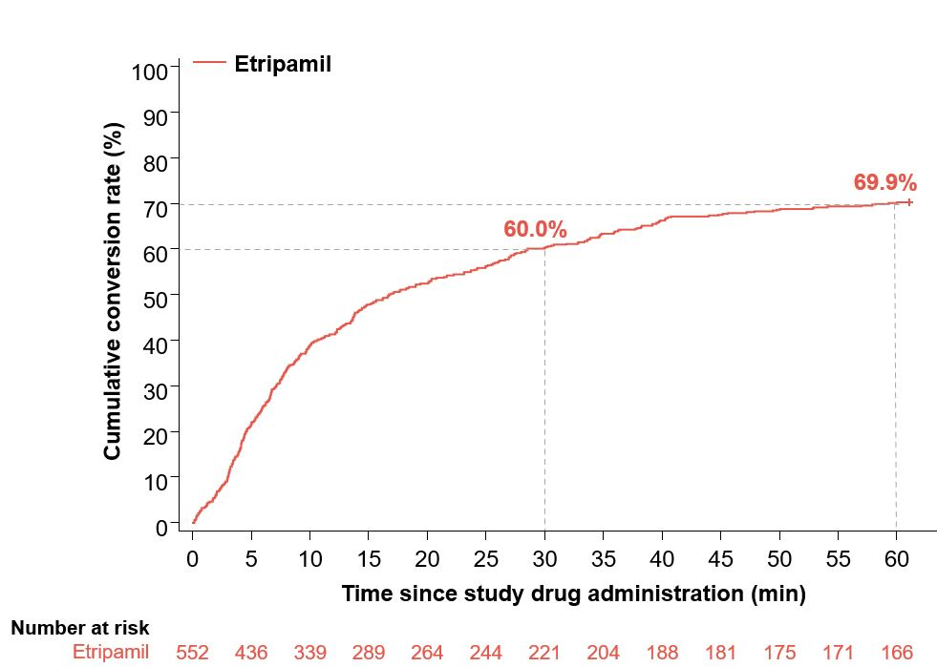
Conversion of PSVT to SR: All Episodes (Efficacy Population)
Secondary Efficacy Assessments
KM Estimate of PSVT Conversion to Sinus Rhythm | By 30 Minutes | By 60 Minutes
NODE-301 | 53.7 | 63.7
NODE-302 | 60.2 | 75.1
RAPID | 64.3 | 73.5
NODE-303 | 60 | 69.9
Median time to conversion:
17.0 min (95% CI, 13.9–22.3)

Slide 10
Additional Secondary Endpoints
Kaplan-Meier Analyses of Confirmed PSVT to SR Conversion at 60 Minutes by Episode (Efficacy Population)
 | All Episodes | Episode 1 (n=312) | Episode 2 (n=151) | Episode 3 (n=71) | Episode 4 (n=18)
Kaplan-Meier Estimate of Patients Converted to SR Within 60 min, %ª | 69.9 | 70.5 | 73.5 | 57.7 | 77.8
Time to Conversion, min
Q1 (95% CI) | 6.0 (5.0, 6.8) | 6.6 (5.1, 7.5) | 4.9 (4.2, 6.6)) | 6.0 (3.3, 9.1) | 6.0 (0.3, 13.9)
Median (95% CI) | 17.0 (13.9, 22.3) | 18.3 (14.2, 25.6) | 14.0 (9.7, 24.2) | 19.1 (9.8, -) | 15.6 (6.0, 33.7)
Q3 (95% CI) | - (-, -)^{b} | - (58.1, -)^{b} | - (36.4, -)^{b} | - (-, -)^{b} | 34.7 (16.3, -)^{b}

Slide 11
Overview of Treatment-Emergent Adverse Events (Safety Population)
TEAE Category (Safety Population N=503) | Events, n | Patients, n (%)
Any TEAE | 997 | 301 (59.8)
Severe | 43 | 31 (6.2)
Any TEAE 24 h | 776 | 269 (53.5)
Severe | 22 | 16 (3.2)
Serious TEAE | 33 | 26 (5.2)
Drug related | 0 | 0
Leading to deathª | 4 | 4 (0.8)
Serious TEAE 24 h | 5 | 5 (1.0)
Drug related | 0 | 0
Leading to death | 0 | 0
Drug-related TEAE | 719 | 250 (49.7)
Severe | 19 | 14 (2.8)
Drug-related TEAE 24 h | 706 | 249 (49.5)
Severe | 19 | 14 (2.8)
TEAE leading to study drug discontinuation | 40 | 26 (5.2)
Drug related | 24 | 12 (2.4)
TEAE 24 h leading to study drug discontinuation | 31 | 18 (3.6)
Drug related | 24 | 12 (2.4)
Any clinical AESI 24 h | 22^{b} | 17 (3.4)^{b,c}
ªTEAEs leading to death were not related to etripamil and include acute myocardial infarction, cardio-respiratory arrest, septic shock and high-grade B cell lymphoma. ^{b}AESIs were identified by the Investigator and do not include those identified from the CMS data. ^{c}An additional clinical AESI (mild hypotension) was identified in one additional patient post-database lock.
AESI=AE of special interest. TEAE=treatment-emergent adverse event, TEAE 24h=TEAE occurring ≤24h after study drug.

Slide 12
Summary of Drug-Related TEAEs Leading to Study Drug Discontinuation
 | Drug-Related TEAEs* (N=503)
System Organ Class Preferred Term | No. of Events | n (%)
Any TEAE | 24 | 12 (2.4)
Gastrointestinal disorders | 1 | 1 (0.2)
Oral discomfort | 1 | 1 (0.2)
General disorders and administration site conditions | 1 | 1 (0.2)
Facial pain | 1 | 1 (0.2)
Nervous system disorders | 2 | 2 (0.4)
Syncopeª | 1 | 1 (0.2)
Hypoaesthesia | 1 | 1 (0.2)
Respiratory, thoracic, and mediastinal disorders | 19 | 9 (1.8)
Nasal discomfort | 7 | 7 (1.4)
Epistaxis | 3 | 3 (0.6)
Nasal congestion | 3 | 3 (0.6)
Rhinalgia | 2 | 2 (0.4)
Cough | 1 | 1 (0.2)
Rhinorrhea | 1 | 1 (0.2)
Sneezing | 1 | 1 (0.2)
Throat irritation | 1 | 1 (0.2)
Vascular disorders | 1 | 1 (0.2)
Hypotension^{b} | 1 | 1 (0.2)
*TEAE defined as AE with a start date occurring after administration of study drug
TEAE= treatment-emergent adverse event
ªOne patient with reported syncope 5 min after etripamil administration, however, investigation showed no reported loss of consciousness, judged as no syncope by study sponsor. ^{b}One patient experienced an event of hypotension 1 hour and 6 min after etripamil administration while in PSVT in the ER (BP 72/27 mm Hg). Patient restored to NSR after cardioversion. The investigator considered the event of hypotension as severe in intensity and probably related to etripamil. The study sponsor considered the event of hypotension as unlikely related to etripamil due to elapsed time between event and drug administration based on the half-life of etripamil.

Slide 13
Most Common (≥5%) Treatment-Emergent Adverse Events
Within 24 h After Etripamil Administration (Safety Population)
TEAE 24 h | Single Dose (70 mg) (N=428) |  | Optional Repeat Dose (2 × 70 mg) (N=75) |  | Total Safety Population (N=503)
System organ class Preferred term | Events, n | Patients, n (%) | Events, n | Patients, n (%) | Events, n | Patients, n (%)
Any TEAE 24 h | 652 | 228 (53.3) | 124 | 41 (54.7) | 776 | 269 (53.5)
Gastrointestinal disorders | 24 | 21 (4.9) | 5 | 5 (6.7) | 29 | 26 (5.2)
Nausea | 5 | 5 (1.2) | 4 | 4 (5.3) | 9 | 9 (1.8)
Nervous system disorders | 65 | 42 (9.8) | 5 | 4 (5.3) | 70 | 46 (9.1)
Headache | 32 | 23 (5.4) | 4 | 3 (4.0) | 36 | 26 (5.2)
Respiratory, thoracic, and mediastinal disorders | 485 | 198 (46.3) | 97 | 39 (52.0) | 582 | 237 (47.1)
Nasal discomfort | 189 | 126 (29.4) | 43 | 26 (34.7) | 232 | 152 (30.2)
Nasal congestion | 80 | 59 (13.8) | 13 | 11 (14.7) | 93 | 70 (13.9)
Rhinorrhea | 76 | 54 (12.6) | 18 | 12 (16.0) | 94 | 66 (13.1)
Epistaxis | 39 | 33 (7.7) | 6 | 4 (5.3) | 45 | 37 (7.4)

Slide 14
TEAEs of Special Interest (Safety Population)
 | Single Dose (70 mg) (N=428) |  | Repeat Dose (2 × 70 mg) (N=75) |  | Total Safety Population (N=503)
System Organ Class Preferred Term | Events, n | Patients, n (%) | No. of Events | n (%) | No. of Events | n (%)
Any AEs | 20 | 15 (3.5) | 3 | 3 (4.0) | 23 | 18 (3.6)
Cardiac disorders | 6 | 3 (0.7) | 3 | 3 (4.0) | 9 | 6 (1.2)
Sinus arrest (≥3 seconds) | 2 | 1 (0.2) | 1 | 1 (1.3) | 3 | 2 (0.4)
Atrioventricular block, first degree | 1 | 1 (0.2) | 1 | 1 (1.3) | 2 | 2 (0.4)
Atrioventricular block, second degree | 2 | 1 (0.2) | 0 | 0 | 2 | 1 (0.2)
Atrioventricular block, third degree | 0 | 0 | 0 | 0 | 0 | 0
Atrial flutter | 0 | 0 | 1ª | 1 (1.3) | 1 | 1 (0.2)
Atrial fibrillation | 1^{b} | 1 (0.2) | 0 | 0 | 1 | 1 (0.2)
Nervous system disorders | 12 | 10 (2.3) | 0 | 0 | 12 | 10 (2.0)
Dizziness | 11^{c} | 9 (2.1) | 0 | 0 | 11 | 9 (1.8)
Syncope | 1^{d} | 1 (0.2) | 0 | 0 | 1 | 1 (0.2)
Vascular disorders | 2 | 2 (0.5) | 0 | 0 | 2 | 2 (0.4)
Hypotension | 2e | 2 (0.5) | 0 | 0 | 2 | 2 (0.4)

Slide 15
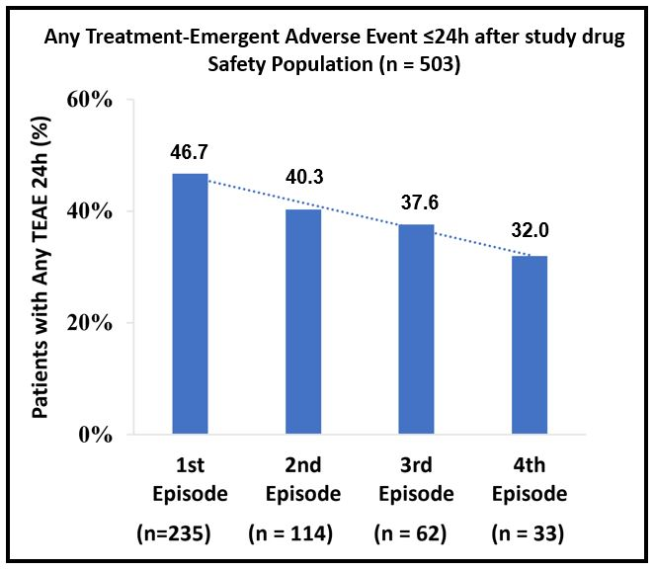
Downward Trend in Treatment-Emergent Adverse Events
Within 24 h With Repeat Episodes

Slide 16
NODE-303: Summary and Conclusions
NODE-303 was the first study to evaluate treatment of multiple episodes of PSVT with single and optional repeat-dose etripamil, self-administered outside of the healthcare setting as prompted by PSVT symptoms, without a prior medically supervised test dose
The safety profile of etripamil in NODE-303 was similar to that observed in previous randomized trials of etripamil
  Most treatment-emergent AEs on the day of self-administration (TEAEs 24 h) were transient, mild, or moderate, and localized to the site of etripamil administration, most commonly nasal discomfort, nasal congestion, rhinorrhea, and epistaxis
  There were no serious drug-related TEAEs
Efficacy of conversion of PSVT and restoration of SR was demonstrated over multiple episodes (up to 4)
to a similar degree and with a similar time to median conversion compared with prior trial data
The results of this study are consistent with previous clinical studies and support the potential benefit of
self-administration of etripamil in treating PSVT in a medically unsupervised setting without the need for prior test dosing

Slide 17
NODE-303 Trial Sites and Investigators
United States
Roger Damle, Littleton, CO
Julian J. Javier, Naples, FL
James H. Crenshaw, Jackson, TN
Ashit Jain, Fremont, CA
James Lovell, West Des Moines, IA
Steven Hearne, Salisbury, MD
Theodore Takata, Fort Worth, TX
Hamdan Firas, Canton, OH
George Mark, Elmer, NJ
Mauricio Hong, Austin, TX
Marco Guerrero, Saint Paul, MN
Patricia Tung, Boston, MA
Dan Pierce, Columbia, MO
James E. Ip, New York, NY
Todd Lewis, Augustine, FL
David Henderson, Daytona Beach, FL
Peter Noseworthy, Rochester, MN
James Liu, Charlotte, NC
Nolan Mayer, Ventura, CA
Hanh Bui, Vista, CA
Christopher Schulze, Yardley, PA
Aamer Qureshi, Charlotte, NC
Mark Napoli, Monroe, LA
Adel Mina, Peoria, IL
Huy Phan, Gilbert, AZ
Rajesh Kabra, Memphis, TN
Mario Gonzalez, Hershey, PA
Abraham Jacob, Plano, TX
Tamas Balogh, Mount Airy, NC
Ronald Polinsky, Wyomissing, PA
Gregory Fazio, York, PA
Jeff Hsing, Corvallis, OR
Thomas R. Kambur, Charlotte, NC
David E. Schleinkofer, Fort Wayne, IN
Manuel Sanchez, Hialeah, FL
Steven Isserman, Morganton, NC
Faizan Iftikhar, McKinney, TX
Syed Jafri, Allen Park, MI
Felix Sogade, Macon, GA
Craig McPherson, Bridgeport, CT
Sean Donahoe, Riverhead, NY
Antonio Blanco, Miami, FL
Praveen Rao, Dallas, TX
Richard Kuk, Lynchburg, VA
Ethan Levine, Rapid City, SD
Greg Olsovsky, Temple, TX
Ramandeep Brar, Los Alamitos, CA
Stephen Devenport, Riverton, UT
Andres Vasquez Donado, Houston, TX
Mohan Viswanathan, Stanford, CA
Adam Lottick, Trumbull, CT
Charles Joyner, Richmond, VA
Khalid Ahmed, Flint, MI
Brian Ramza, Kansas City, MO
Srivani Ambati, Apex, NC
Jorge Cheirif, Dallas, TX
Joseph Moran, Statesville, NC
Mirel Sanchez, Miami, FL
Sander Fernandez, Orlando, FL
Giselle Debs-Perez, North Miami Beach, FL
Luis Mas, Cutler Bay, FL
Kenneth Ellenbogen, Richmond, VA
Gaurang Gandhi, Cincinnati, OH
Javier E. Banchs, Round Rock, TX
Ayham Shneker, San Antonio, TX
Patrick Weston, Bradenton, FL
Andrea Natale, Austin, TX
Harinder Gogia, Anaheim, CA
Paris Bradsford, Beaumont, TX
Michele Cook, Coeur D’Alene, ID
Michael Rosenberg, Aurora, CO
Richard Beasley, Rapid City, SD
Idania Fernandez, Hialeah, FL
William Randall, Dayton, OH
Johnny Dy, Lenoir, NC
Canada
John Vyselaar, North Vancouver, BC
Benoit Coutu, Montréal, QC
Daniel Savard, St-Jean-sur-Richelieu, QC
Jean-Francois Roux, Sherbrooke, QC
Matthew Bennett, Vancouver, BC
A. Shekhar Pandey, Cambridge, ON
Ariane Lemiux, Lévis, QC
Blandine Mondésert, Montréal, QC
James Cha, Oshawa, ON
Sebastien-Xavier Joncas, Quebec, QC
Raja Chehayeb, Greenfield Park, QC
Jeffrey Sean Healey, East Hamilton, ON
Yves Pesant, St. Jerome, QC
Frank Halperin, Kelowna, BC
Stephen Wilton, Calgary, AB
Sherryn Roth, Scarborough, ON
Marc Deyell, Vancouver, BC
Atilio Costa-Vitali, Sudbury, ON
Joseph Berlingieri, Burlington, ON
Kapil Bhagirath, Surrey, BC
Argentina
Maximiliano Sicer, Santa Fe
Luis Ignacio Mondragón, Caba
Sonia Sassone, Buenos Aires
Rubén Omar García Durán, Buenos Aires
Alberto Liberman, Cordoba
Fernando Botto, Buenos Aires
Gabriela Carnero, Salta
Maria Leonor Parody, Cordoba
Matias Lugo, Buenos Aires
Ignacio MacKinnon, Buenos Aires
Carlos Cuneo, Salta
Oscar Montaña, Buenos Aires
Andrés Alvarisqueta, Buenos Aires
Guillermo Caime, Buenos Aires
Marisa Liliana Vico, Buenos Aires
Luis Domingo Pozzer, Corrientes
Martin Horacio Koretzky, Buenos Aires
Diego Martinez, Cordoba
Fernando Colombo Berra, Buenos Aires
Brazil
Ana Claudia Venancio, Minas Gerais
Jamil Abdalla Saad, Minas Gerais
Wladmir Saporito, Sao Paulo
Christiano de Luca Nassif, Sao Paulo
Luiz Carlos Santana Passos, Bahia
Mauricio Scanavacca, Sao Paulo
Audes Feitosa, Pernambuco
Benhur Henz, Distrito Federal
Yorghos Michalaros, Minas Gerais
Eduardo Ramacciotti, Sao Paulo
Rodrigo Alves da Silva, Minas Gerais
Jose Francisco Kerr Saraiva, Sao Paulo
Juliano Novaes Cardoso, Sao Paulo
Fabio Tuche, Rio de Janeiro
Heron Rhydan Saad Rached, Sao Paulo
Eduardo Bartholomay, Rio Grande do Sul
Maria Vidotti, Sao Paulo
Mauro Esteves Hernandes, Sao Paulo
Adalberto Menezes Lorga Filho, Sao Paulo
Aguinaldo Freitas Junior, Sao Paulo
Colombia
Ricardo Leon Fernandez Ruiz, Antioquia
Fernando Manzur, Bolivar
Juan Fernando Carvajal Estupiñan, Santander
Franklin Quiroz, Santander
Attallah Antonio Rizcala Muvdi, Atlantico
Gregorio Sanchez Vallejo, Armenia

Slide 18

NODE-303: Multi-Center, Multi-National, Open-Label, Safety Study of Etripamil Nasal Spray for Patients With Paroxysmal Supraventricular Tachycardia
Now published online:
James E. Ip, MD¹; Benoit Coutu, MD²; John H. Ip, MD³; Peter A. Noseworthy, MD, MBA⁴; Maria L. Parody, MD⁵; Farhad Rafii, MD⁶; Samuel F. Sears, PhD⁷; Narendra Singh, MD⁸; Bruce Stambler, MD⁹; Naeem K. Tahirkheli, MD¹⁰; Juan Agudelo Uribe, MD¹¹;
Sarah Omodele, DNP, FNP¹²; Silvia Shardonofsky, MD¹²; David B. Bharucha, MD, PhD¹²; A. John Camm, MD¹³
(1) Weill Cornell Medical Center, New York Presbyterian Hospital, New York, USA (2) Montréal University Hospital Center, Montréal, QC, Canada (3) Edward W. Sparrow Hospital Association, Sparrow Thoracic and Cardiovascular Institute, Lansing, MI, USA (4) Mayo Clinic, Rochester, MN, USA (5) Hospital San Roque, San Roque, Argentina (6) lnterventional Cardiology Medical Group, West Hills, CA, USA (7) East Carolina University, Psychology and Cardiovascular Sciences, Greenville, NC, USA (8) NSC Research Center, Johns Creek, GA, USA (9) Piedmont Heart Institute, Atlanta, GA, USA (10) Oklahoma Heart Hospital, Oklahoma City, OK, USA (11)Clinical CardioVID, Medellin, Colombia (12) Milestone Pharmaceuticals, Montréal, QC, Canada (13) St George's University of London, London, United Kingdom

